Slide 1

ALERT – Addressing Research Gaps in Radio Frequency Machine Learning
Philip Leong (philip.leong@sydney.edu.au)
Notes:
Title: ALERT – Addressing Research Gaps in Radio Frequency Machine Learning
Speaker: Prof Philip Leong, School of Electrical and Computer Engineering, The University of Sydney
Abstract: Advances in software-defined radio and deep learning (DL) have enabled radio signals to be detected and classified more accurately than using conventional digital signal processing techniques. However, gaps in radio frequency machine learning (RFML) research regarding suitable Algorithms, Latency, Edge implementations, Representation and Training (ALERT) techniques remain. In the Computer Engineering Laboratory at the University of Sydney, we have been designing FPGA-based accelerators for cyclostationary signal processing and low-precision edge-based training for RFML applications. This talk elaborates on the research gaps and our efforts to address them.
Biography: Philip Leong (梁恆惠) received the B.Sc., B.E. and Ph.D. degrees from the University of Sydney. 1993 he was a consultant to ST Microelectronics in Milan, Italy working on advanced flash memory-based integrated circuit design. From 1997-2009 he was with the Chinese University of Hong Kong. He is currently Professor of Computer Systems in the School of Electrical and Computer Engineering at the University of Sydney, Chief Technology Advisor to ClusterTech, Chief Technology Officer at CruxML and Chief Executive Officer at TernaryNet.

Slide 2
Acknowledgment of Country
I acknowledge the Gadigal people of the Eora Nation as the traditional custodians of the land on which the university stands and pay respects to Elders past, present and emerging.

Slide 3

Australia vs Taiwan
More than 200x larger than Taiwan
Population about the same
27.0M vs 23.4M in 2023

Slide 4
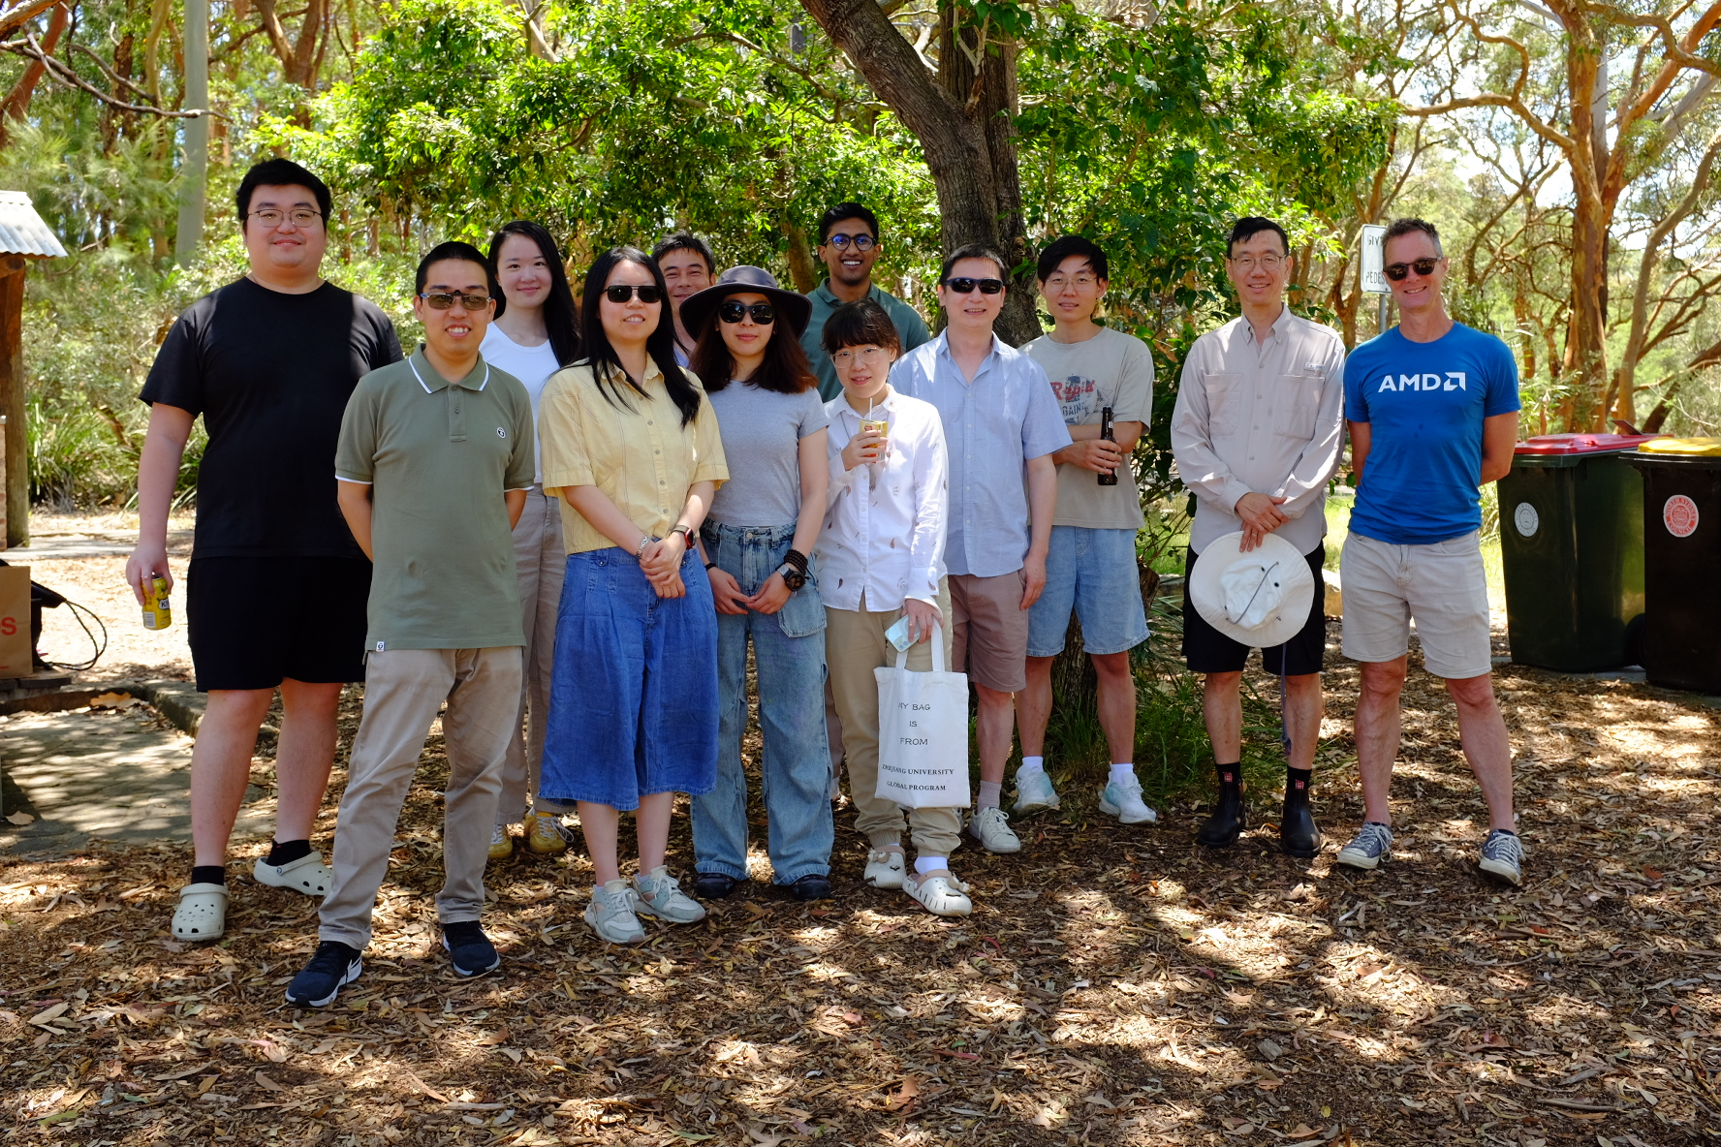
Computer Engineering Lab
Introduction
CEL focuses on how to utilise parallelism to solve computing problems
Novel architectures, applications and design techniques
Notes:
1.Differemce with bfp
2. No BM training

Slide 5
Radio Frequency Machine Learning
Processing RF signals remains a challenge
ML offers an opportunity to achieve RF scene understanding
Overall research theme is to achieve high performance in RFML using FPGAs through (EPIC)
Exploration, Parallelism, Integration, Customisation

Slide 6
Collaborators
AMD/Xilinx, Intel
Main Sequence Ventures
Australian Economic Accelerator (AEA)

Slide 7
Outline
Opportunities for RFML on FPGAs
Features (Cyclostationary Signal Processing)
Training at the edge (Block Minifloats)
Current Work

Slide 8
1. Opportunities for FPGAs in RFML

Slide 9
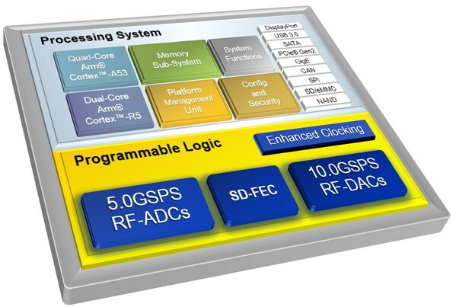
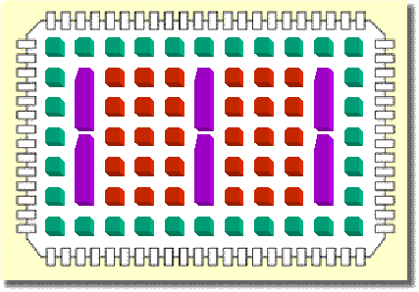
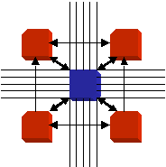
What is an FPGA?
User-customisable integrated circuit
Configurable logic blocks
Dedicated blocks
Input and output blocks
Routing
* Clocking Resources

Slide 10
Requirements for RFML
Requirements
High throughput, low latency, good accuracy, integration
Some research gaps (ALERT)
Algorithms
Latency
Edge
Representations (features)
Training (to adapt to changing conditions)

Slide 11
Some Ways to Bridge Gaps
Algorithms: lower complexity techniques with minimal accuracy reduction
Latency: highly pipelined architectures, quantisation, hardware-friendly DNN techniques
Edge: single-FPGA solutions that reduce off-chip communications and utilise massive on-chip bandwidth, integration, memory footprint reduction
Representations: techniques that match properties of signals, e.g. complex numbers, man-made modulation schemes
Training: systems that can adapt to changing conditions

Slide 12
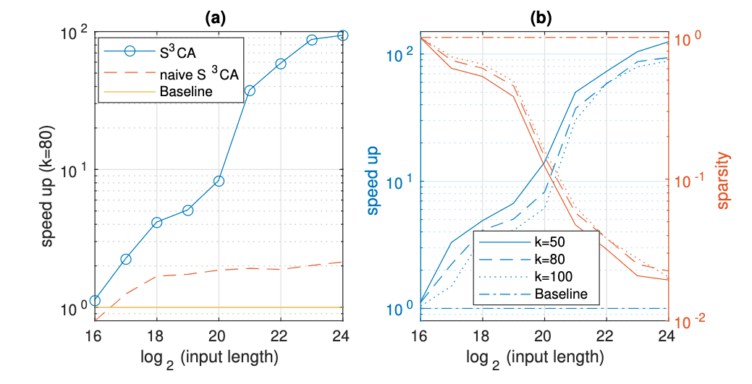
ALERT Algorithms: Sparse FFT [1]

Slide 13
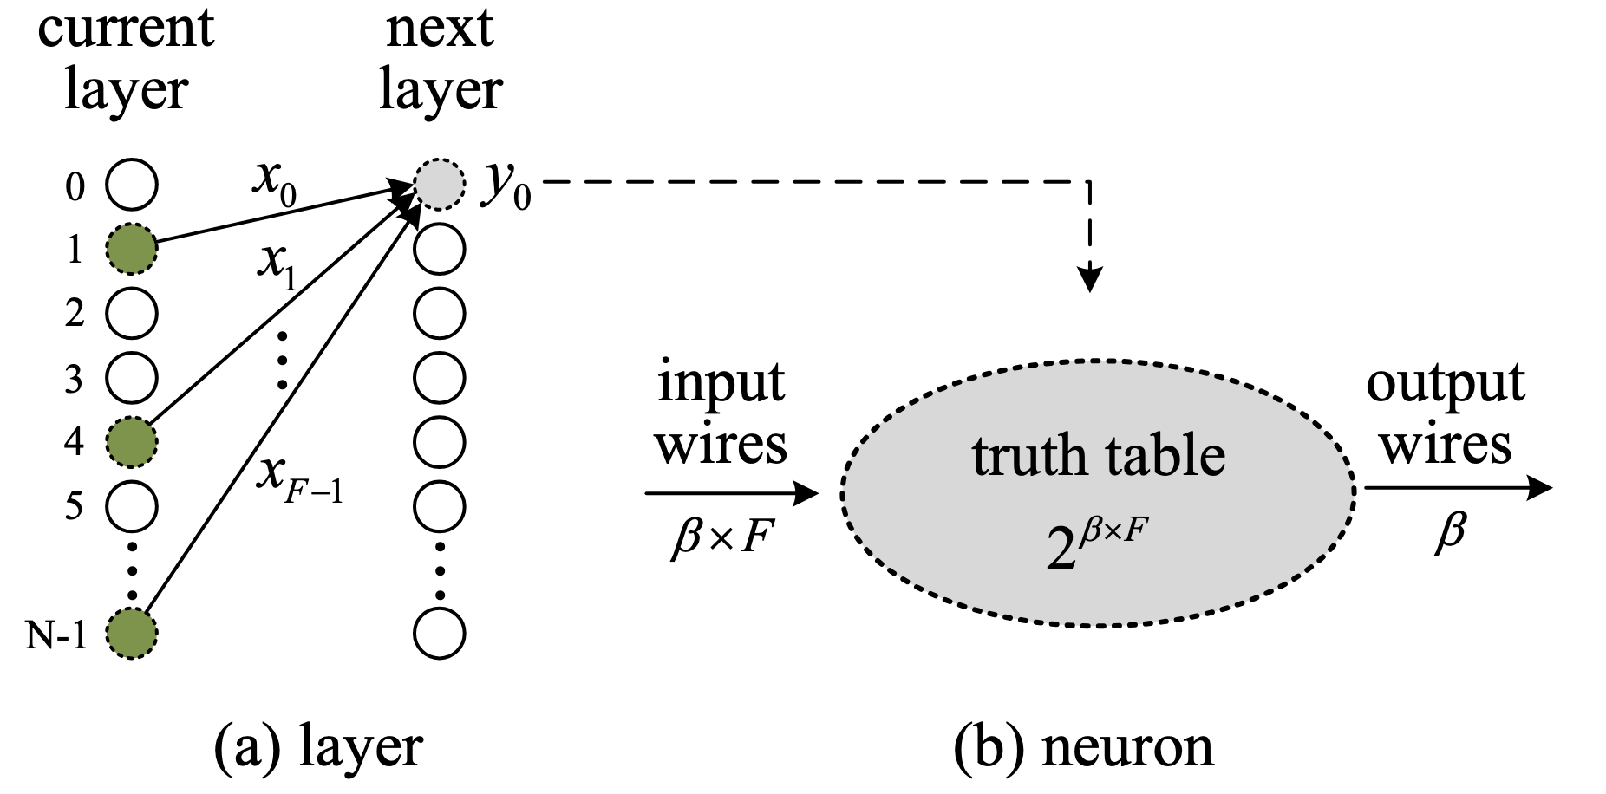
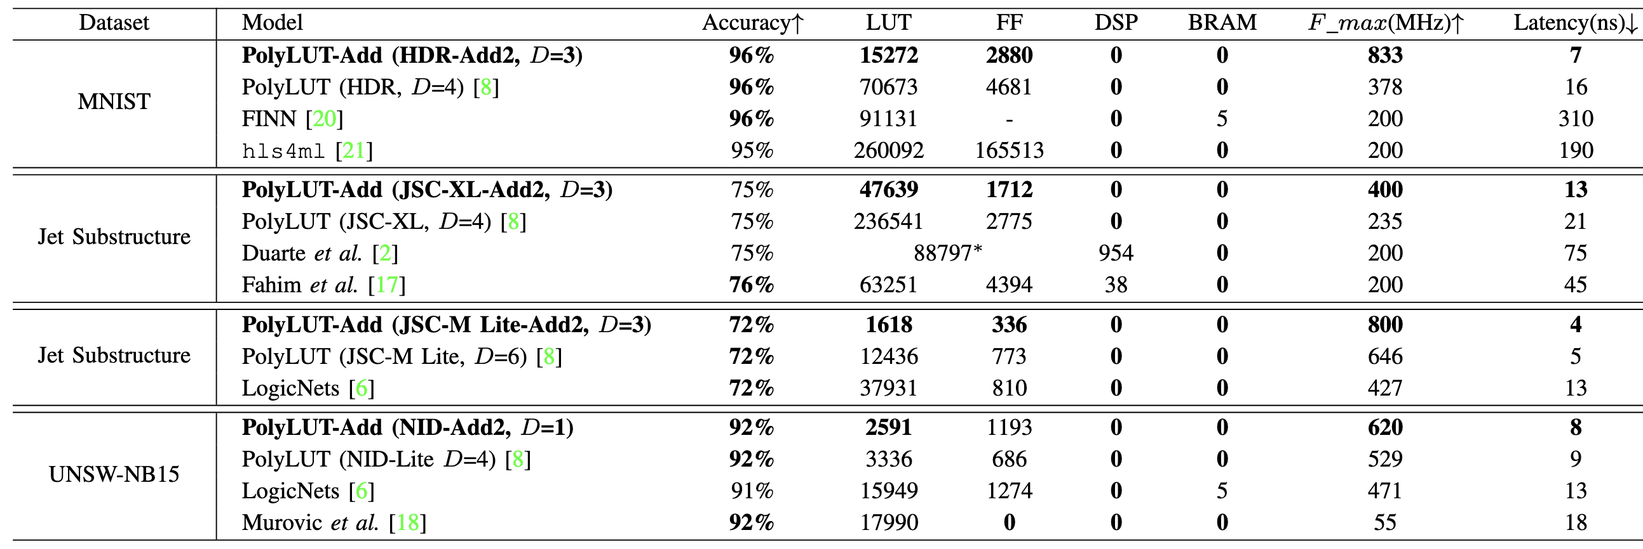
ALERT Latency: PolyLUT-Add [2]
Each neuron implemented in a single LUT
https://github.com/bingleilou/PolyLUT-Add

Slide 14
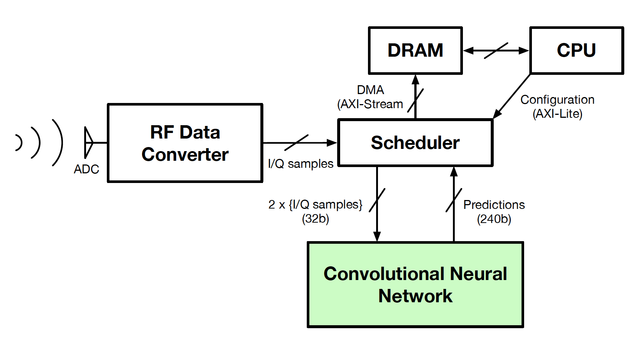
ALERT Edge: Modulation Classification @ 500 Msps [3]
Combine quantisation, sparsity and CSE to reduce computation 86%
Fully pipelined design achieves
- 488K classifications/s
- 8 uS latency
https://phwl.org/assets/papers/amc_raw20.pdf

Slide 15
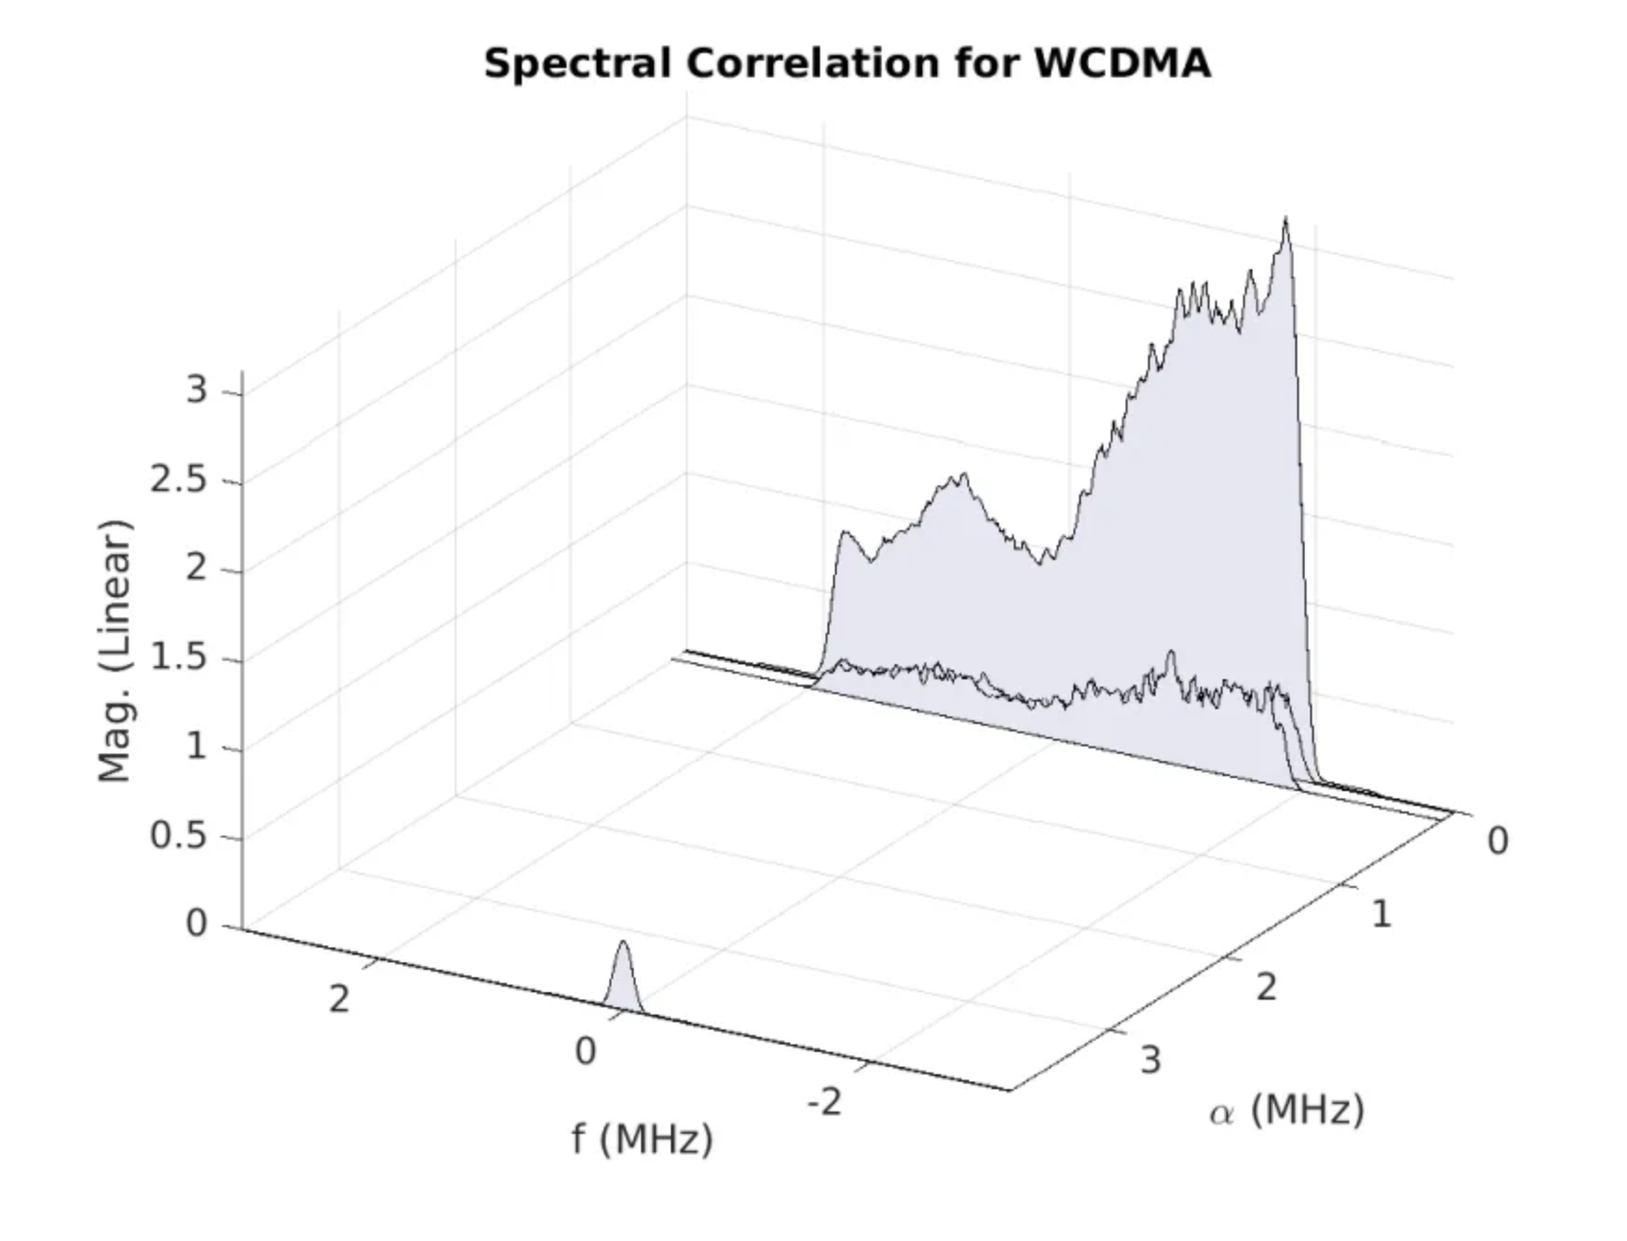
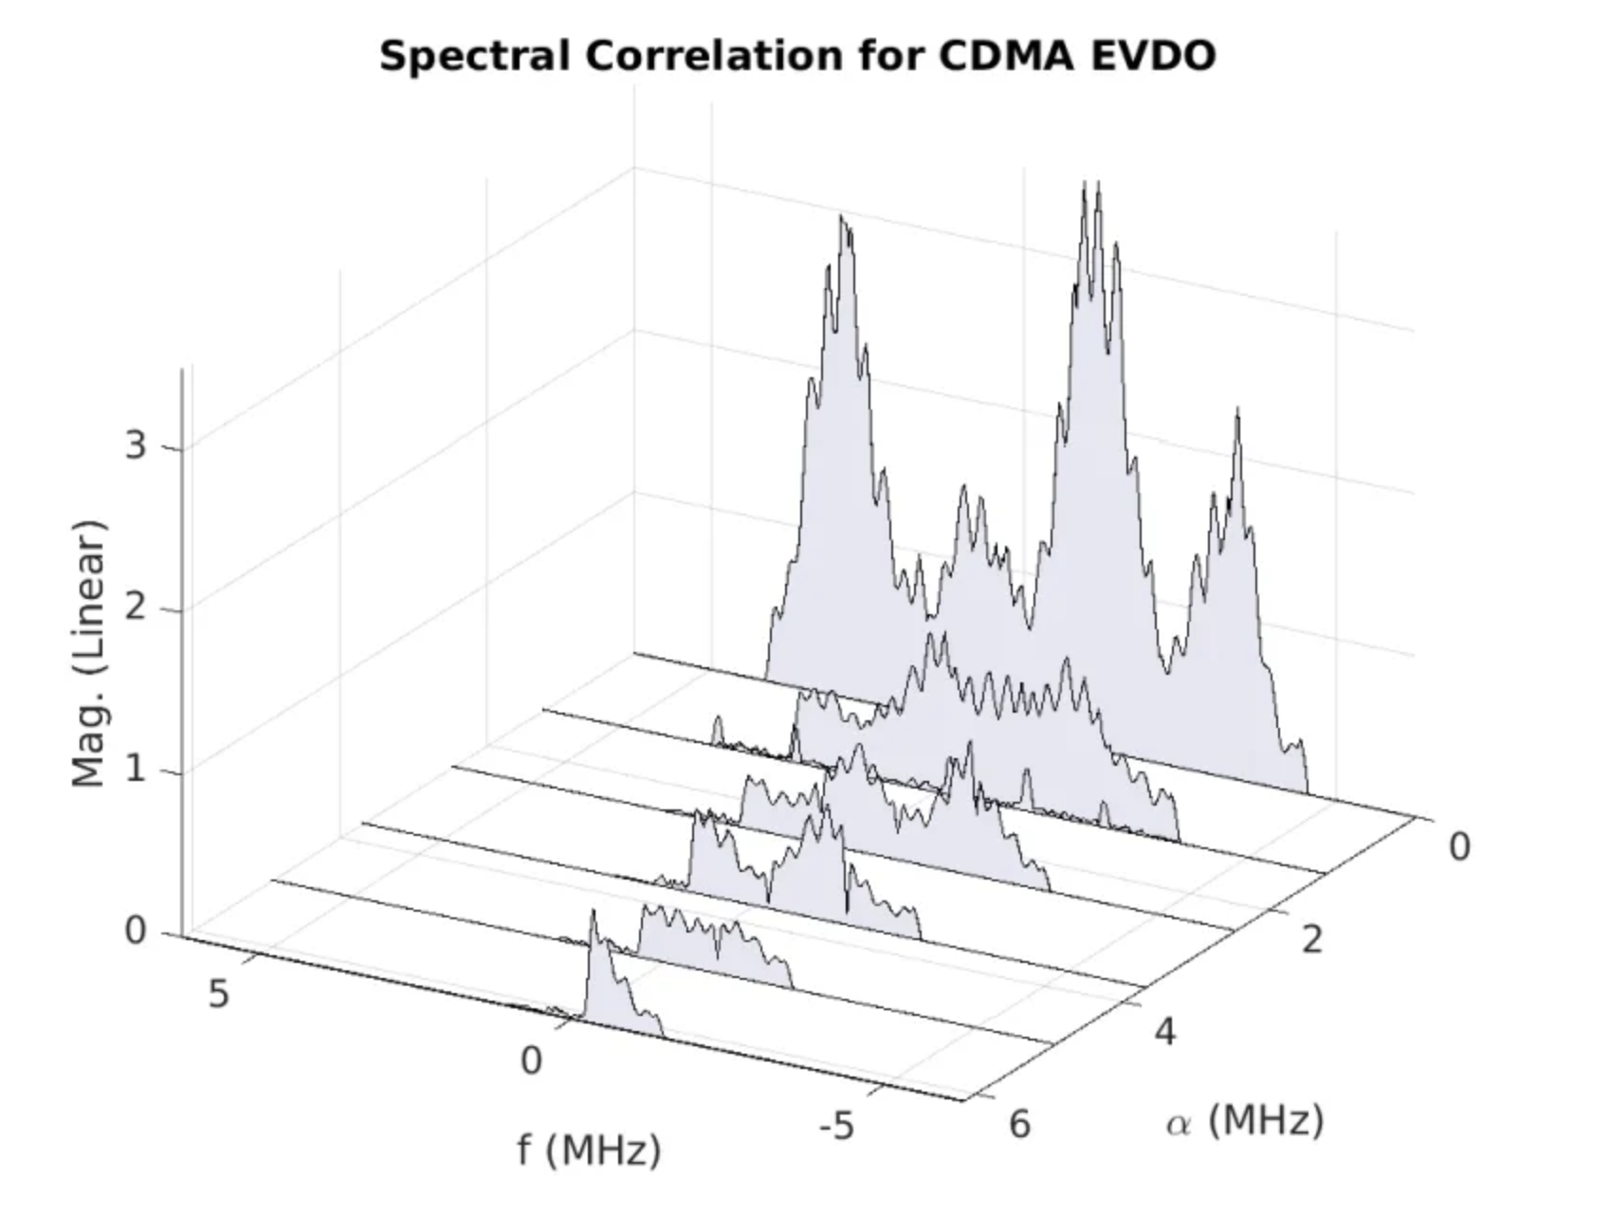
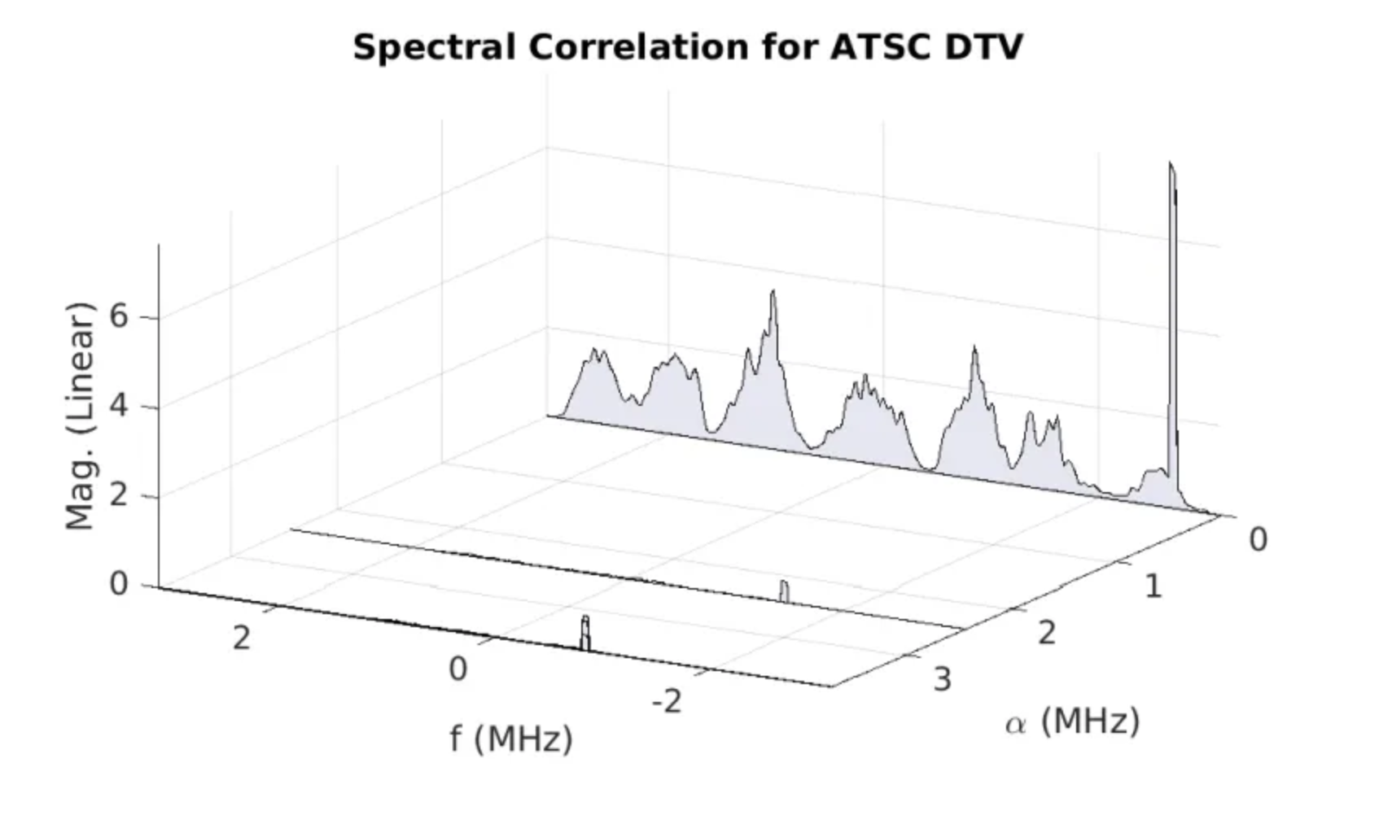
ALERT Representations: Cyclostationary Features [4]
Cyclostationary: probability distribution changes periodically over time
Excellent at low SNR (but computationally expensive)

Slide 16
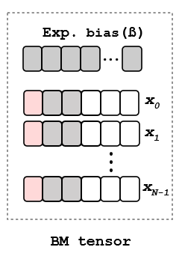
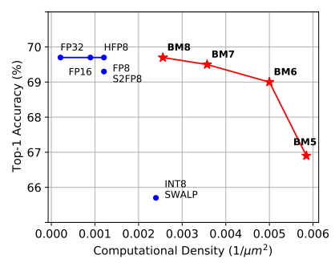
ALERT Training: Training of DNNs at the Edge [5]
Block minifloats which can train with 8 and 6-bit precision
Dataset: ImageNet
Model: ResNet-18
ICML’21 https://openreview.net/forum?id=6zaTwpNSsQ2

Slide 17
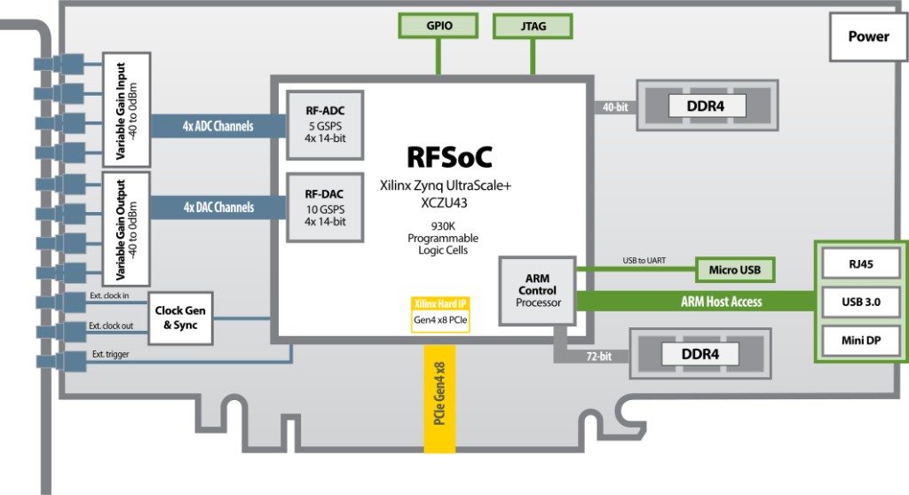
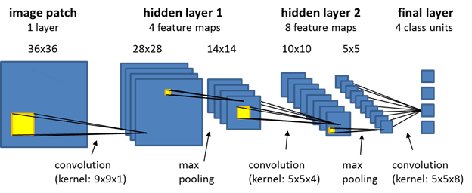
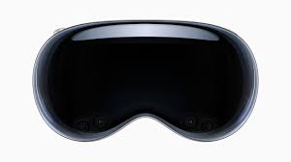

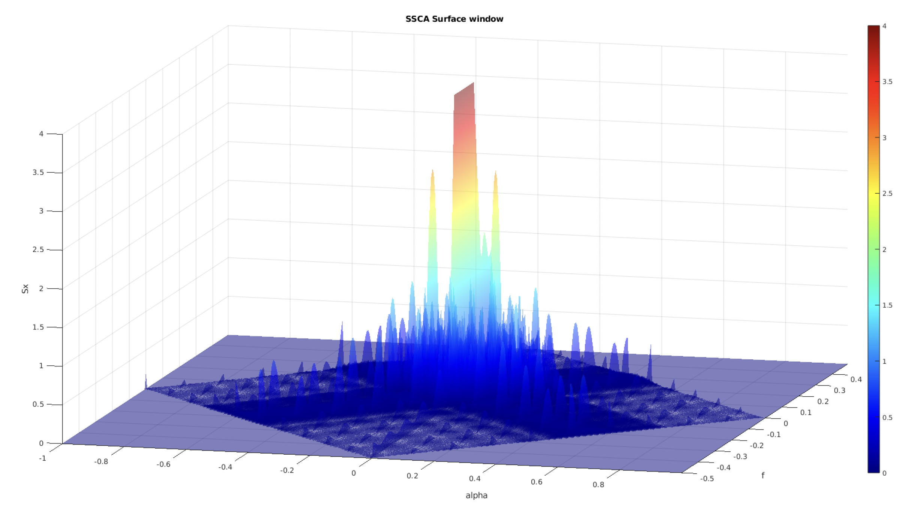
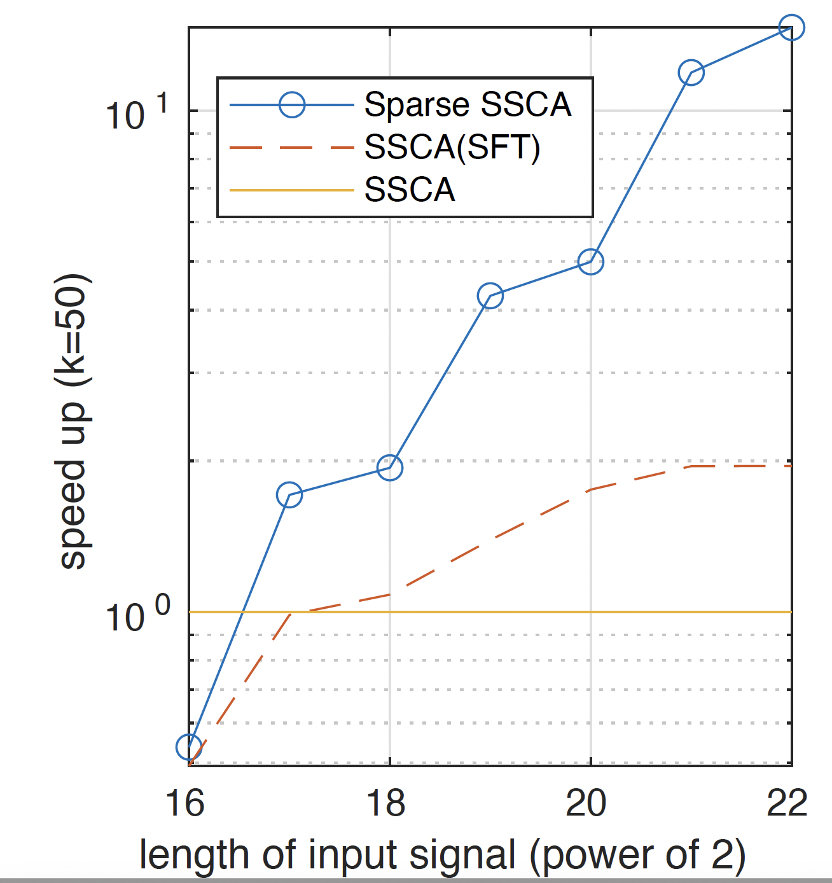

A Vision for RF Scene Understanding
Combine real-time FPGA HW, cyclostationary analysis, ML and AR
Emitter Localization
ML on FPGA
Apple Vision Pro
Input Length
Cyclostationary Signal Processing (CSP)
10x Acceleration
of CSP in SW (TRL 3)
RF Fingerprinting
on FPGA

Slide 18
2. Representations: Cyclostationary Features [4]

Slide 19
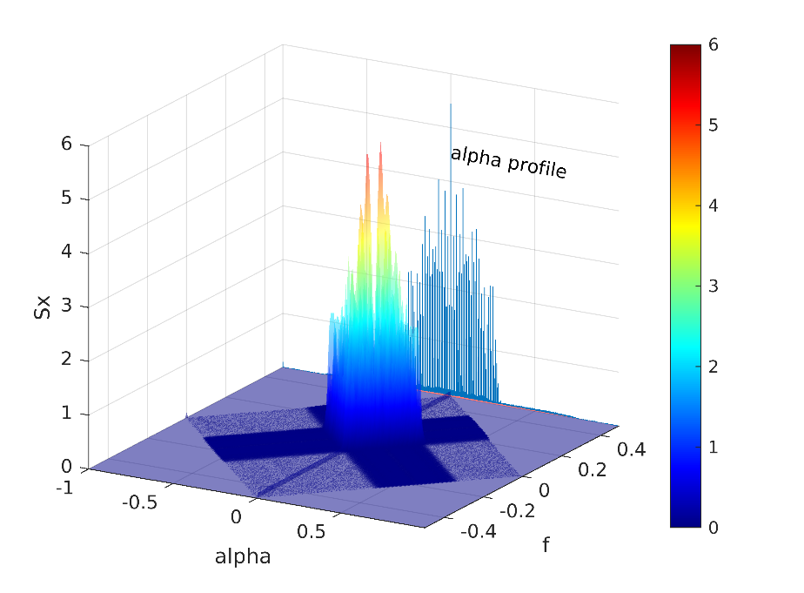
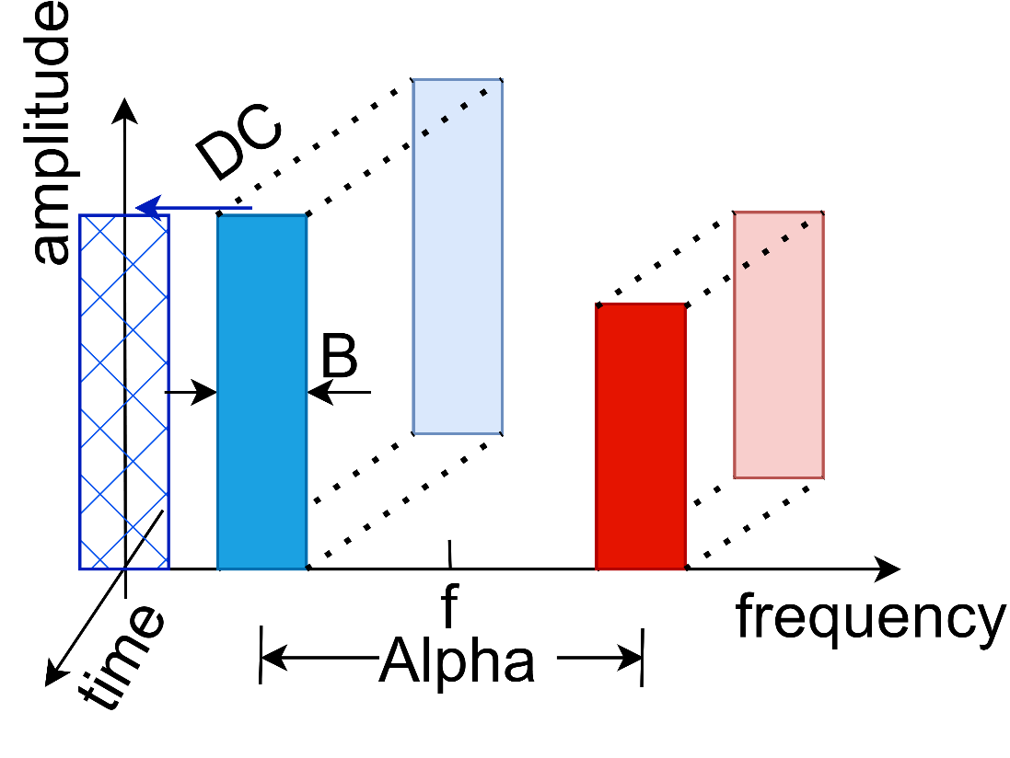

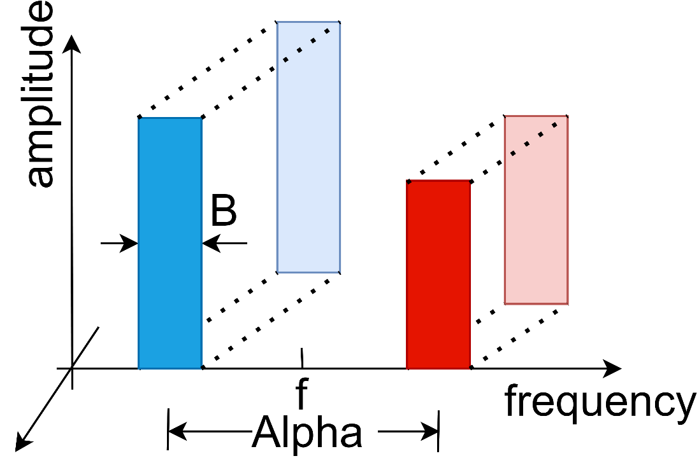
Cyclostationarity
A time series is said to be cyclostationary if its probability distribution varies periodically with time.
Spectral Correlation Density:

Slide 20
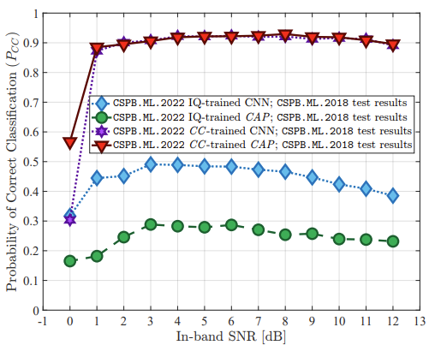
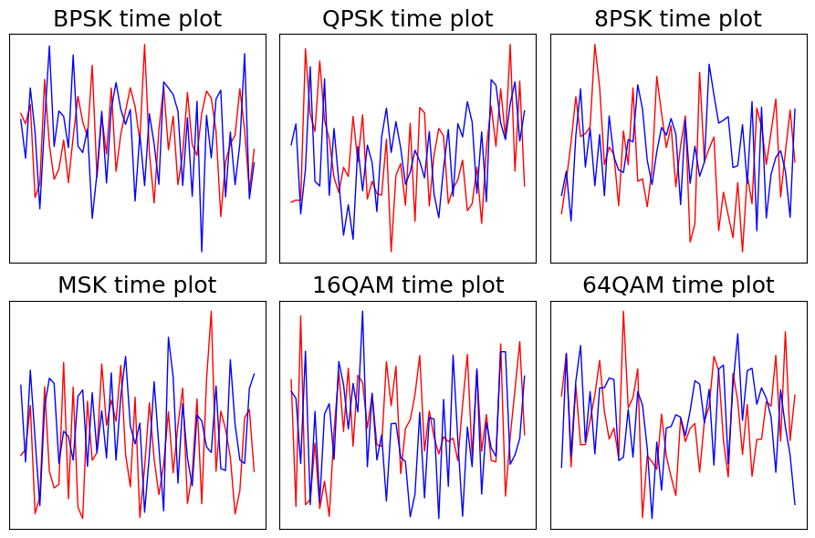
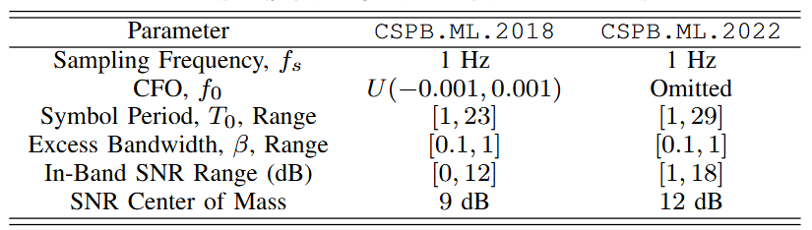
Introduction
Training
with SCD
Training
with IQ
Automatic Modulation Classification (AMC)
“eyes & ears” of Cognitive Radio
SCD can be used for AMC at low SNR
J. A. Snoap, J. A. Latshaw, D. C. Popescu and C. M. Spooner, "Robust Classification of Digitally
Modulated Signals Using Capsule Networks and Cyclic Cumulant Features," MILCOM 2022

Slide 21
Contribution
First high-performance SCD estimation on Versal platforms using the FAM and SSCA techniques.
Fully reproducible designs and results*.
First AIE-only FAM implementation
Uses only 35% of AIEs
Requires zero PL resources → RFML + ML integration
First FPGA-accelerated SSCA implementation
Uses decomposed FFT + PL transpose
Handles ~1M sample window sizes efficiently
*: https://github.com/Jingyi-li/SCD_VCK5000

Slide 22

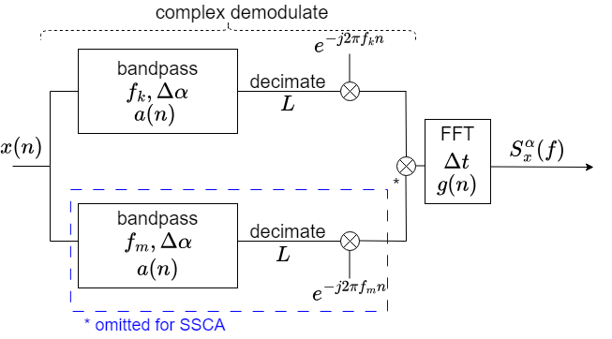
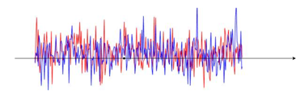
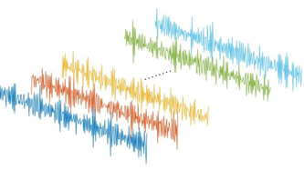
Spectral Correlation Density (SCD)
FFT Accumulation Method (FAM)
Strip Spectral Correlation Analyzer (SSCA)
Challenge:
High computational complexity makes it difficult to use in real-time applications.
Notes:
The FFT accumulation method (FAM) is am efficient way to estimate the spectral correlation density (which we will refer to as the SCD) using the Fourier Transform. The bandpass filters are implemented using an FFT, after which decimation and downconversion are applied. A second FFT is used to compute the final SCD output. The alpha profile is a 1-dimensional version of the SCD in which the maximum value of cyclic frequency is computed.
The FAM is computationally expensive making it difficult to apply in real-time applications.

Slide 23
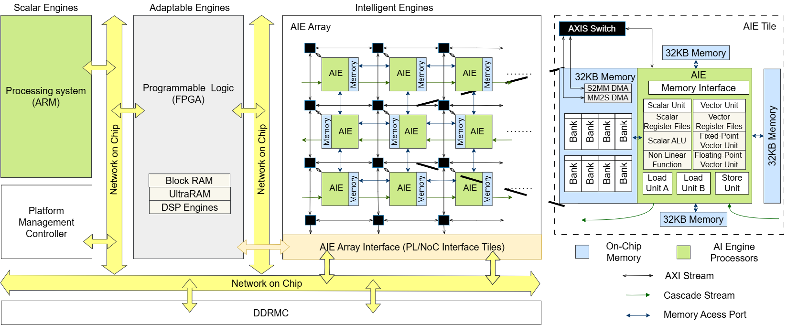
AMD/Xilinx Versal ACAP Architecture
8TFLOPS/s
20GFLOPS/s = 1.25GHz x 8MACs/cycle x (add+multi)
400 AIE processors
Notes:
The AMD/Xilinx Versal ACAP architecture (Versal architecture), which merges general-purpose CPUs, programmable logic (PL), and AI Engine (AIE) processors optimised for AI and machine learning optimisation. With 400 AIE processors executing at a maximum 1.25 GHz, capable of delivering 8 MACs/cycles for 32-bit floating-point data, it has peak performance of 8 tera floating point operations per second (TOPS). It turns out the 64K memory is the main constraint for our work.

Slide 24
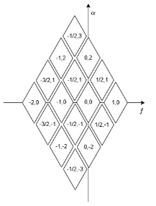
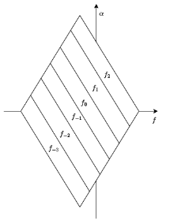
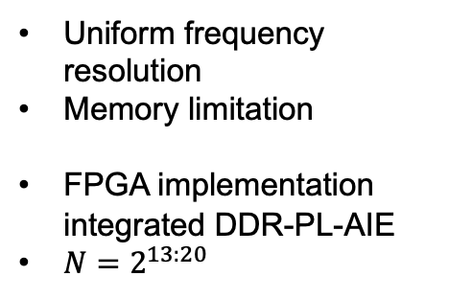
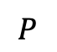
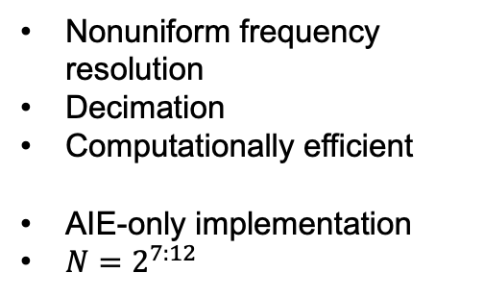
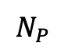
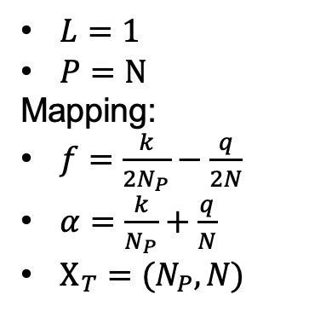
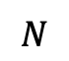
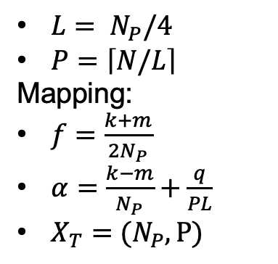
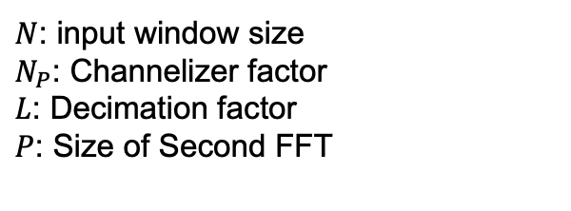
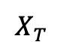
FAM & SSCA
FAM
$L= N_{P}/4$
$P=\left\lceil N/L\right\rceil$
Mapping:
$f=\frac{k+m}{2N_{P}}$
$α=\frac{k−m}{N_{P}}+\frac{q}{PL}$
$X_{T}=(N_{P},P)$
Nonuniform frequency resolution
Decimation
Computationally efficient
AIE-only implementation
$N=2^{7:12}$
$$X_{T}$$
$$N_{P}$$
$$N$$
SSCA
$$P$$
$L=1$
$P=N$
Mapping:
$f=\frac{k}{2N_{P}}−\frac{q}{2N}$
$α=\frac{k}{N_{P}}+\frac{q}{N}$
$X_{T}=(N_{P},N)$
Uniform frequency resolution
Memory limitation
FPGA implementation integrated DDR-PL-AIE
$N=2^{13:20}$
$N$: input window size
$N_{P}$: Channelizer factor
$L$: Decimation factor
$P$: Size of Second FFT

Slide 25
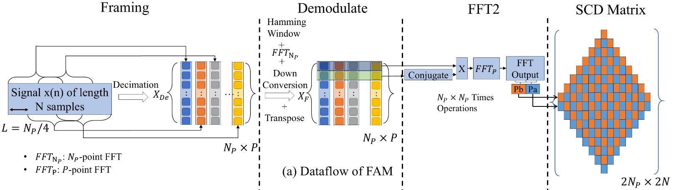
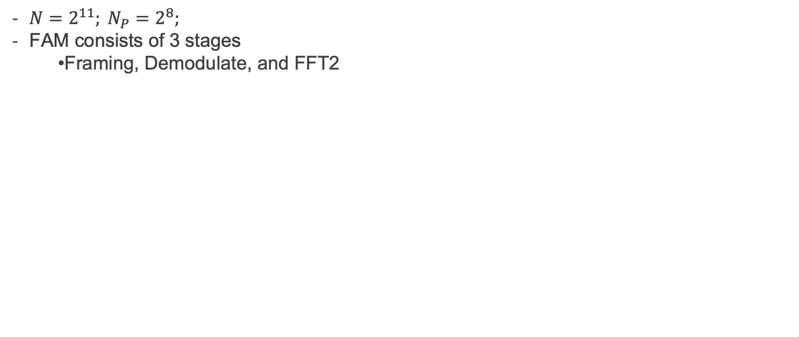
AIE-only FAM Implementation
$N=2^{11}; N_{P}=2^{8};$
FAM consists of 3 stages
Framing, Demodulate, and FFT2

Slide 26
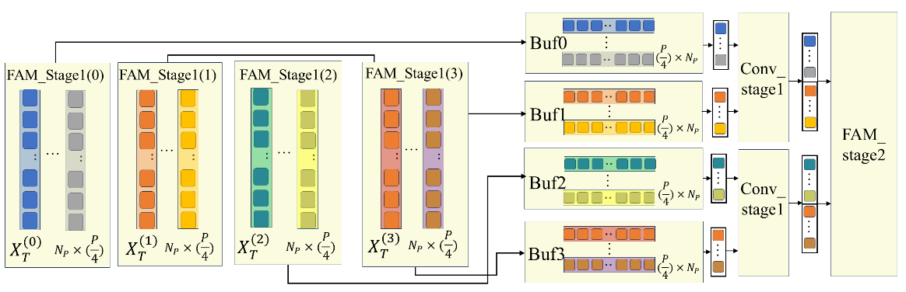
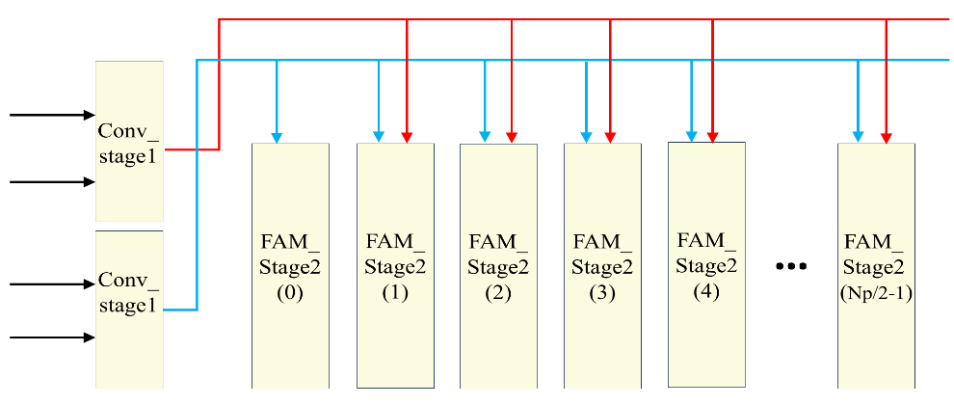
Parallelism for FAM
Transpose
Broadcast

Slide 27
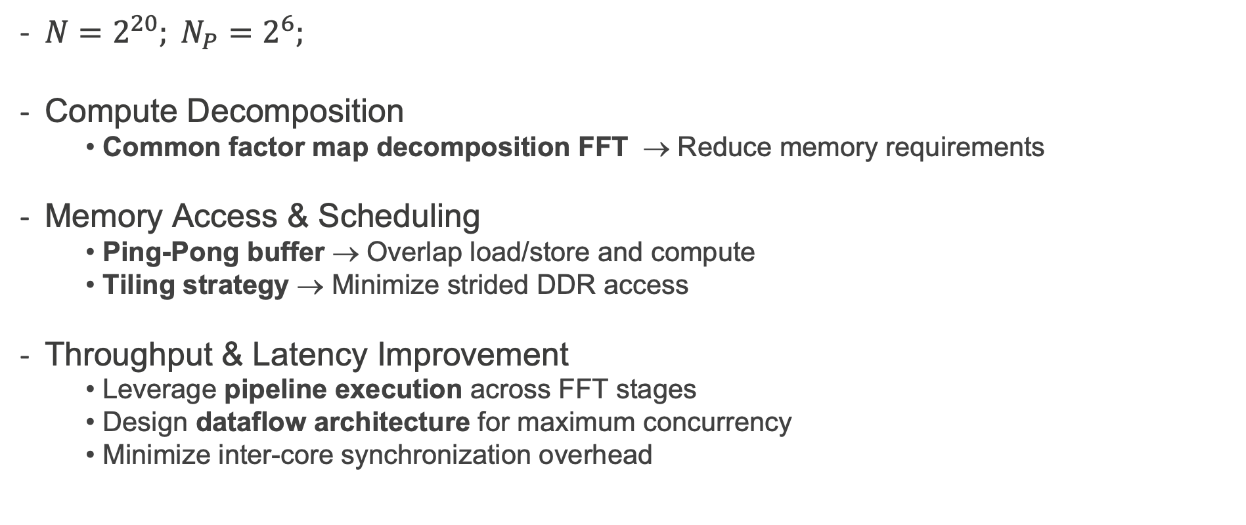
SSCA Implementation
$N=2^{20}; N_{P}=2^{6};$
Compute Decomposition
Common factor map decomposition FFT → Reduce memory requirements
Memory Access & Scheduling
Ping-Pong buffer → Overlap load/store and compute
Tiling strategy → Minimize strided DDR access
Throughput & Latency Improvement
Leverage pipeline execution across FFT stages
Design dataflow architecture for maximum concurrency
Minimize inter-core synchronization overhead

Slide 28
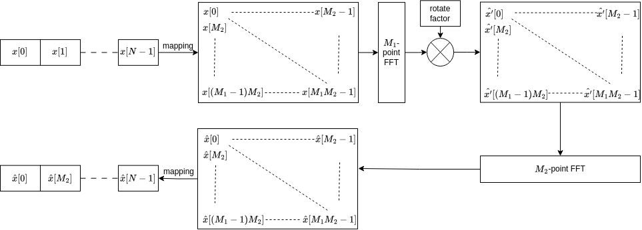
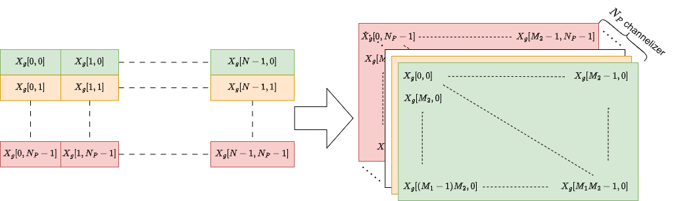
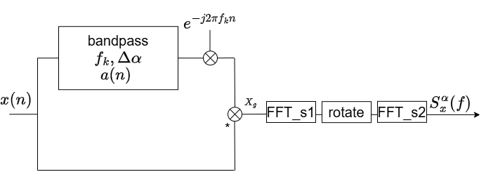
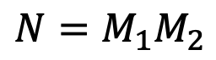
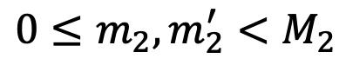
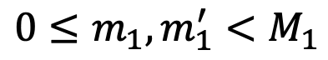
Common Factor Map Decomposition FFT
$$N=M_{1}M_{2}$$
$$0≤m_{1}, m_{1}^{′}<M_{1}$$
N-point FFT
$$0≤m_{2}, m_{2}^{′}<M_{2}$$

Slide 29







SSCA_2DFFT on Versal
2DFFT
CDP
Pipeline
CDP: II = data stream in
Dataflow
$$M_{1}≥M_{2}$$
Parallel $\frac{M_{1}}{N_{P}}$ CDP
Parallel $\frac{M_{1}}{M_{2}}{FFT}_{M_{2}}$
Tiling Strategy
Ping-Pong Buffer
1st
2nd
Notes:
What CDP is

Slide 30




Results (1)
FAM | SSCA
$$N=2,048$$ | $$N=1,048,576$$
$$N_{P}=256$$ | $$N_{P}=64$$
$$L=64$$ | $$L=1$$
$$P=32$$ | $$P=N=1,048,576$$
Single Precision: FAM 9.94e-5, SSCA 1.08e-6
 | PL |  |  |  | AIE Array
 | Register | LUT | BRAM | URAM | AIE tile | PLIO
Total Resources | 1,739,432 | 860,336 | 933 | 463 | 400 | -
FAM | 113,686 (6.61%) | 107,601 (12.73%) | 37 (3.97%) | 0 (0.00%) | 137 (34.25%) | 130
SSCA_2DFFT | 15,475 (0.89%) | 11,824 (1.37%) | 349 (37.41%) | 192 (41.47%) | 15 (3.75%) | 13
Notes:
Floating point computing

Slide 31

Results (2)
 | FAM |  | SSCA
 | Time | Speedup | Time | Speedup
CPU | 0.194s | 1 | 11.3a | 1
GPU | 2.791ms | 69.51 | 217ms | 52.07
VCK5000 | 0.630ms | 307.94 | 114ms | 99.12
 | FAM_ZCU111[1] | FAM_VCK5000 | SSCA_2DFFT_VCK5000
Input window size | 2,048 | 2,048 | 1,048,576
Initiation Interval (ms) | 0.164 | 0.63 | 114
Throughput (MS/s) | 12.50 | 3.25 | 9.21
Computational Performance (GPOS) | 460 | 189 | 88
Board Power (W) | 35 | 40 | 31
[1] “Fixed-point FPGA implementation of the FFT accumulation method for real-time cyclostationary analysis” ACM Trans.

Slide 32

Summary
Presented open-source, efficient implementations of the FAM and SSCA techniques on Versal ACAP
FAM uses 34% of AIE resources and 12% of LUTs
First reported SSCA implementation N=1M uses 4% AIE and 1% LUTs
This work enables integration of software defined radio, cyclostationary and ML on a single device for cognitive radio applications

Slide 33
3. Training: FPGA-based Block Minifloat Training Accelerator for a Time Series Prediction Network [5]

Slide 34

Motivation (1)
What can we do to reduce the energy cost?

Slide 35
Motivation (2)
Introduction
Target problem: Training on Edge
Potential: adapt to local conditions
Problem: ~3x memory and compute vs. inference
Solution: Use custom number system

Slide 36
Block Minifloat (BM)
Itroduction
BM = minifloat + shared exponent bias β
minifloat: small floating-point format (same idea as Microscaling MX)
E
E
E
M
M
M
M
M
M
M
M
M
M
M
M
M
M
M
M
M
M
M
M
M
M
M
M
M
M
M
M
M
M
M
M
M
M
M
M
M
M
M
M
M
M
M
M
M
M
M
M
Fixed
BFP
E
E
E
M
E
M
E
M
E
M
E
M
E
M
E
M
E
M
E
M
E
M
E
M
E
M
E
M
E
M
E
M
E
M
E
M
E
M
E
M
E
M
E
M
E
M
E
M
E
M
E
Minifloat
Block Minifloat and Microscaling (MX)
Notes:
1.Differemce with bfp
2. No BM training

Slide 37

Block Minifloat (BM)
Itroduction
BM = minifloat + shared exponent bias β
minifloat: small floating-point format (same idea as Microscaling MX)
Notes:
1.Differemce with bfp
2. No BM training

Slide 38
Previous Work: BM-Theory (ICLR21)
Introduction
BM units are:
Smaller
Consume less Power
Model: ResNet-18 Dataset: ImageNet
38
Notes:
1.Differemce with bfp
2. No BM training

Slide 39


Previous Work: BM-based TL (ICCAD23)
Introduction
Transfer learning example from CIFAR-100 to CIFAR-10
39
Notes:
1.Differemce with bfp
2. No BM training

Slide 40
This Work
Introduction
BM arithmetic
Block size: A novel technique for cross-block BM matrix multiplication
Mixed precision: BM GEMM kernel with runtime configurable precision for FW/BP with pipeline optimization
DSP packing: 4-bit BM MAC unit with 6 multiplication packed per DSP
Training accelerator
First implementation of 4-bit BM training for time series network (NBEATS)

Slide 41


Block size & mixed precision in BM Matrix multiply
Introduction
Block size
Accuracy
$$A_{k}, e_{k}, W_{k}$$
(mixed precision)
PE array
Problem:
Block size ≠ tile size
Computation error in cross-block MM
Runtime configurable precision GEMM
Shared exponent

Slide 42

Cross-block BM matrix multiplication
BM arithmetic
Step 1: Inner product
Integer based inner-product
Notes:
Rounding error: 1) FMA implemented in integer 2) Psum is given extra tailing bit to reduce truncation error 3) only normalize once to avoid conversion rounding error

Slide 43

Cross-block BM matrix multiplication
BM arithmetic
Step 2: Normalization
Find maximum in the block
Norm: Convert $P[{Blk}^{2}]$ to C
Adjust shared exponent β

Slide 44

PE -- scalar inner-product computation
BM arithmetic
Mixed precision
A mixed-precision decoder in minifloat input
Selectable boundary thresholds in Norm block (Next page)
PE design of GEMM kernel

Slide 45


BM GEMM kernel
BM arithmetic
Pipelined implementation
Inter block & Intra-Normalization Pipeline
PE array
(inner-product)
Find Maximum
inner-product
norm
Normalization

Slide 46


DSP packing
BM arithmetic
DSP packed PE optimized for 4-bit BM training
Each PE has 2*3 input, 6 MAC unit
6 Significand multiplication in MAC mapped to one DSP48E2
Support different precisions during training
DSP packed PE design for 4-bit BM MAC
Bit Arrangement in Different Training Phases

Slide 47

Time series prediction network - NBEATS
Training accelerator
NBEATS: A time series prediction network with regular architecture (FC layer & residual)
SOTA accuracy result on M3, M4 and statistics benchmark
NBEATS block
network

Slide 48


NBEATS training accelerator
Training accelerator

Slide 49

BM GEMM
Experiment
Block size has small impact on GEMM area
(a) Block size configuration

Slide 50

NBEATS training accuracy
Experiment
Smaller block size, high precision residual, Mixed precision improves accuracy

Slide 51
NBEATS training accelerator
Experiment
BM4-mixed packed
Accelerator achieves 779 Gops throughput, DSP utilization 0.7 Gops/DSP (SOTA), power efficiency 42.4 Gops/W (3.1x)
 | Ours (no packing) | Ours (packing) | GPU
Device | Alveo U50 |  | GTX 1080
Process | TSMC 16nm
Num system | BM4-mixed | BM4-mixed | FP32
Freq.(MHz) | 183 | 159 | 1733
Tput. (Gops) | 299.03 | 779.12 | 2991
Power(W) | 20.86 | 18.38 | 220
Gops/W | 14.34 | 42.4 | 13.6
Gops/DSP | 0.27 | 0.71 | -

Slide 52
Summary
Demonstrated FPGA-based 4-bit training of time series prediction networks with minimal impact on accuracy
Systolic array that combines mixed precision and DSP packing
3x Gops/W in same technology as GPU
Suitable for edge-based systems with modest energy resources

Slide 53
4. Current Work

Slide 54

ONRG Understanding Deep Learning-based RFF
With Kanchana Thilakarathna
Create dataset generators where physical mechanisms can be controlled. Collect OTA data.
Understand how tx and channel imperfections affect the activations of a DL-RFF via XAI.
Test hypothesis: XAI + systematic study of hardware impairments and channel models can improve robustness and model interpretability.

Slide 55

AEA Decreasing Precision Trend

Slide 56

AEA Ternary Neural Network

Slide 57


Spinoff Companies
TernaryNet
Real-time AI Applications
on FPGAs
Fabless Semiconductor Company

Slide 58
Conclusion
RFML requirements
High throughput, low latency, good accuracy, integration
We have been working to address ALERT gaps
Algorithms through cyclostationary sparse FFT [1]
Latency through PolyLUT-Add [2]
Edge via integration, ternary networks, quantisation and CSE [3]
Representations through cyclostationary features [4]
Training through block minifloat arithmetic [5]

Slide 59
References (available at https://phwl.org/assets/papers/papers)
[1] Carol Jingyi Li, Richard Rademacher, David Boland, Craig T. Jin, Chad M. Spooner, and Philip H.W. Leong. S3CA: a sparse strip spectral correlation analyzer. IEEE Signal Processing Letters, 31():646–650, 2024.
[2] Binglei Lou, Richard Rademacher, David Boland, and Philip H.W. Leong. PolyLUT-Add: FPGA-based LUT inference with wide inputs. In Proc. International Conference on Field Programmable Logic and Applications (FPL), to appear. 2024.
[3] Stephen Tridgell, David Boland, Philip HW Leong, Ryan Kastner, Alireza Khodamoradi, and Siddhartha. Real-time automatic modulation classification using RFSoC. In 2020 IEEE International Parallel and Distributed Processing Symposium Workshops, IPDPSW 2020, New Orleans, LA, USA, May 18-22, 2020, 82–89. IEEE, 2020.
[4] Carol Jingyi Li, Ruilin Wu, and Philip H.W. Leong. AMD Versal Implementations of
FAM and SSCA Estimators. FPT Conference, 2026 (to appear).
[5] Wenjie Zhou, Haoyan Qi, David Boland, and Philip H.W. Leong. Fpga-based block minifloat training accelerator for a time series prediction network. ACM Trans. Reconfigurable Technol. Syst., December 2025. to appear.

